Slide 1



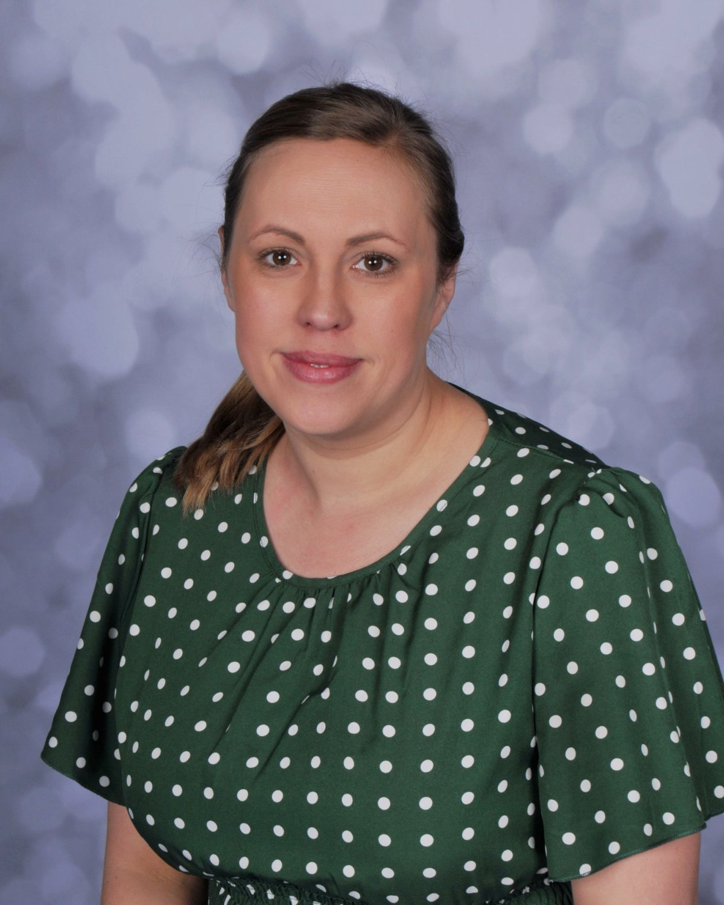

SAFEGUARDING LEADS
Know who to speak to if you have a safeguarding concern
Mrs K Dobson
Mrs L Artley
Mrs L Heald
Miss L Hill
Designated Safeguarding Lead
Deputy Designated Safeguarding Lead
Deputy Designated Safeguarding Lead
Deputy Designated Safeguarding Lead
KCSIE 2026 • Paragraph 2
“Safeguarding and promoting the welfare of children is everyone’s responsibility. ‘Children’ means everyone under the age of 18. In order to fulfil this responsibility effectively, all practitioners should make sure their approach is child centred. This means that they should consider, at all times, what is in the best interests of the child.”
REMEMBER
KCSIE 2026 • Paragraph 8
“Every school and college should have a designated safeguarding lead who will provide support to staff to carry out their safeguarding duties and
who will liaise closely with other services such as local authority children’s social care.”
Keeping Children Safe in Education 2026 • Paragraphs 2 & 8

